Slide 1
HL7® FHIR® Evolution and Status
Lloyd McKenzie
September 30, 2014

Slide 2
This presentation
Can be downloaded here:
http://gforge.hl7.org/svn/fhir/trunk/presentations/2014-09 Tutorials/Evolution and Status.pptx
Use “anonymous” and email address to logon
Is licensed for use under the Creative Commons, specifically:
Creative Commons Attribution 3.0 Unported License
(Do with it as you wish, so long as you give credit)

Slide 3

Who am I?
Name: Lloyd McKenzie
Company: Gordon Point Informatics (GPi)
Background:
One of FHIR’s 3 principle editors
Co-chair FHIR Management Group
Co-chair HL7 Modeling & Methodology
Chair HL7 Canada Architecture & Infrastructure
Heavily involved in HL7 and healthcare exchange for last 15 years (v2, v3, CDA, etc.)

Slide 4
Tutorial Objectives
You should:
Be up to speed on FHIR-related news from the HL7 Working Group meeting and associated connectathons
Understand what new content to expect as part of the next DSTU
Be familiar with the plans for future releases and how FHIR is being used in early adoption
Notes:
9:15

Slide 5
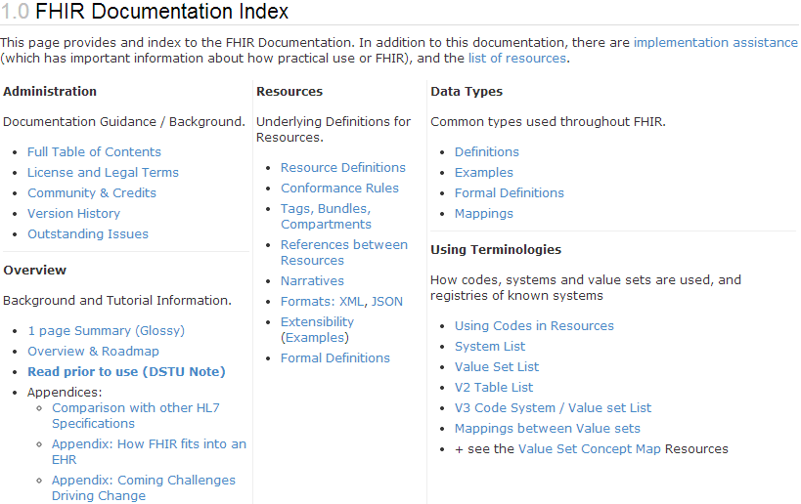
Read me first
“…all aspects of the FHIR specification are potentially subject to change

Slide 6
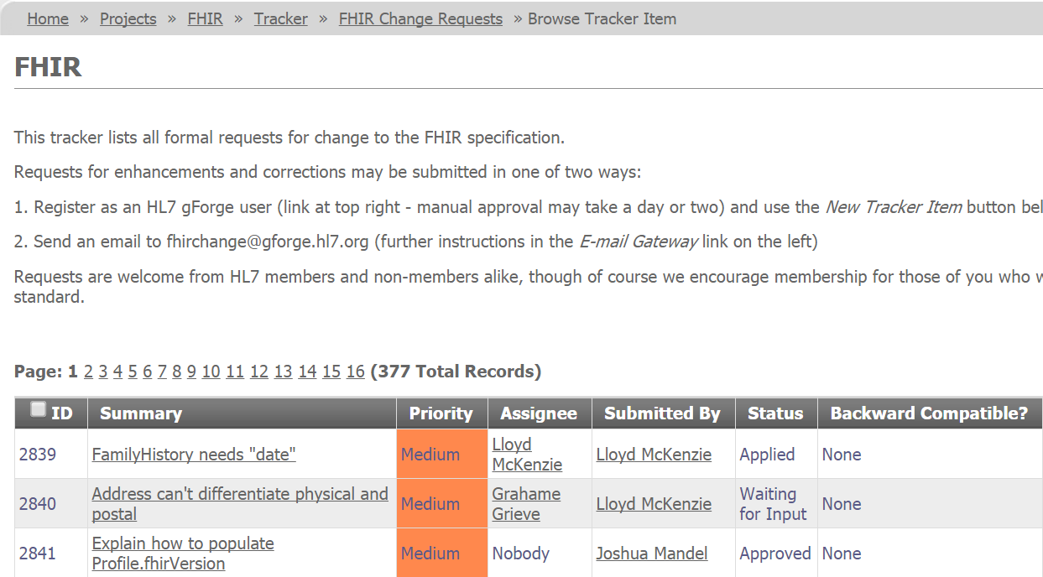
Change Requests to Date

Slide 7
What’s changing?
Some examples:
Questionnaire split into 2 resources
Questionnaire + QuestionnaireAnswers
Revamping of Profile & Value Set
Optimized extension syntax in JSON
and somewhat in XML
New and re-named core elements, data types
E.g. Media.dateTime -> Media.created
Contact -> ContactPoint
Lots of typos, clarifications, improved wording

Slide 8
New license
Have moved from custom license to Creative Commons Public Domain (cc0)
HL7 retains the trademark to the FHIR name and logo
If you wish to use “FHIR” in your product name or the logo in your product or literature, need HL7’s permission
fmgcontact@hl7.org

Slide 9
Other planned changes
QA targets for next release
Improved consistency of names
Domain familiarity still trumps consistency
Clearer definitions and resource boundaries
E.g. When to use Condition vs. Observation
Improved vocabulary
Fewer FHIR-specific codes

Slide 10
New Content
New Resources
Clinical: Referral, ProcedureRequest, RiskAssessment, Nutrition
Scheduling: Appointment, Schedule, Slot
Devices: DevicesCapabilities, DeviceObservation, etc.
Process: ConsentDirective, Contraindication, EpisodeOfCare, HealthcareService, DataElement
Financial: Eligibility, Enrollment, Coverage, Claim, Account, Billing

Slide 11
New Content - Profiles
Core
Migration of Immunization to a profile
Profiles for Nutrition-related activities, etc.
HL7 International
CDA on FHIR
CCDA on FHIR
QUICK (Quality Improvement and Clinical Knowledge)
U.S. Realm (ONC)
Structured Data Capture (SDC)
Data Access Framework (DAF)

Slide 12
New Content - Capabilities
Subscription resource
Supports publish/subscribe
Operation Definition resource
Supports defining simple request/response services (remote procedure calls) and queries
Integration with SCIM for tracking users & permissions
RDF + OWL
In progress, but may not make DSTU 2

Slide 13
New content - Services
Terminology
Expand value set
Validate a code
Translate a code
Questionnaire
Generate a questionnaire from a profile
Generate questionnaire answers based on existing data
Others?
Notes:
Generate a summary observation?

Slide 14
Other changes
Growing community of FHIR implementers
>150 people on the implementer Skype chat
Active FHIR development (pilot and production) in numerous countries
Will be working to stand up a “fhir.org” website to support the community
RFP going out soon for HL7-managed registries for profiles (extensions), value sets, mappings and more.

Slide 15
FHIR is real
Many organizations committed to FHIR as part of SMART on FHIR (now HSPC)
Cerner, Epic, HP, Kaiser, Intermountain Healthcare, Siemens, VA, etc.
Epic now offers FHIR interfaces~70 organizations declared
Veterans Affairs & Department of Defense working on FHIR exchange
Notes:
HSPC = Healthcare Services Platform Consortium

Slide 16
Connectathons
7th Connectathon
61 attendees
Focus on SMART on FHIR (security)
Wide range of participants
Ran out of time to do presentations
Numerous secure connections
Roughly 50% newcomers

Slide 17
Connectathon Participation

Slide 18
Clinical Connectathon
Focused on clinical utility, not technical exchange
About 10 participants
Shared information using a UI based on the FHIR resource
Tools still need work, but will definitely repeat
Likely to become a regular event, just like the technical connectathon

Slide 19
Not just a U.S. thing anymore
Australia – Nov. 6-7
Netherlands – Nov. 24-26
Spain - TBD
Canada – Apr. 23
Tentative
France – May 9-10
HL7 WGM
Notes:
Have had previous connectathons in the UK, Australia and Argentina

Slide 20
Timeline
Draft ballot Dec. 12-Jan 12
2nd DSTU ballot Apr. 10-May 4, 2015
2nd DSTU publication Summer 2015
Normative publication ~2017
Dependent on adoption level and stability

Slide 21
Engagement opportunities
Read the spec: http://hl7.org/fhir
Follow #FHIR on Twitter
Shape the specification:
Make comments (inline, tracker, wiki, etc.)
Try implementing it
Make Ballot comments
Come to a Connectathon!

Slide 22


Education opportunities
Attend a Working Group Meeting
Tutorials, Connectathons
Jan 16-23 San Antonio
May 8-14 Paris
Attend an Implementation Workshop
Intensive tutorials, hands-on
November 10-13 Portland
FHIR Institute Webinars
October 20-24 and December 1-5
FHIR Developer Days
Nov. 24-26 - Amsterdam
http://fhir.furore.com/Events/DevDays2014

Slide 23

Questions?
http://hl7.org/fhir lloyd@lmckenzie.com

